Slide 1
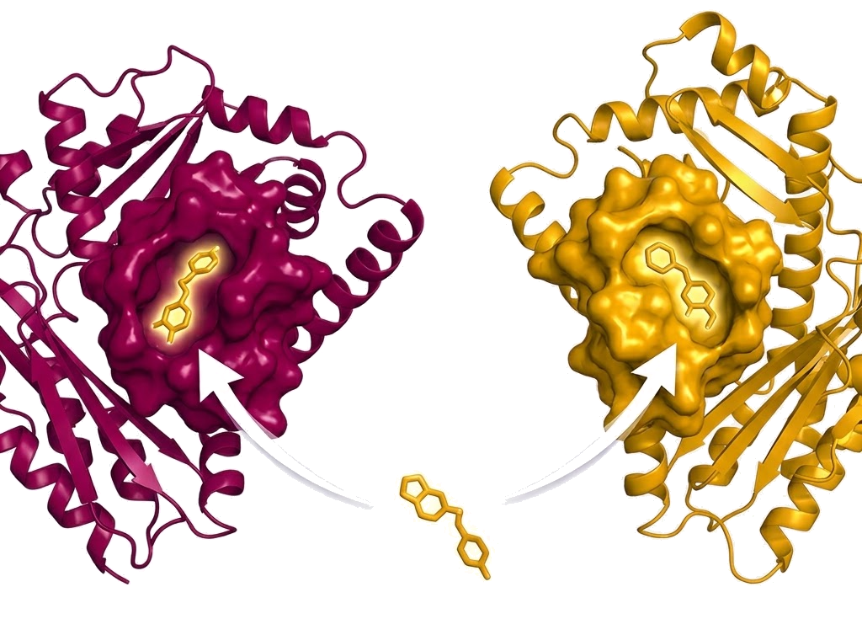
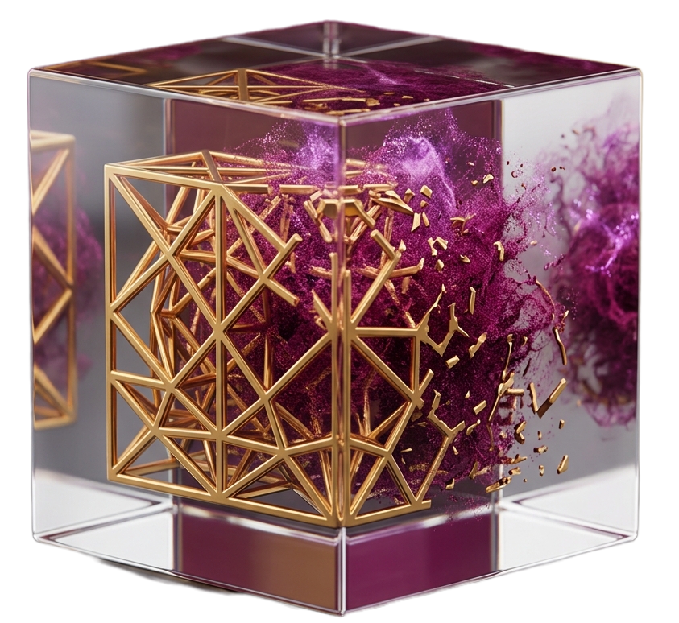
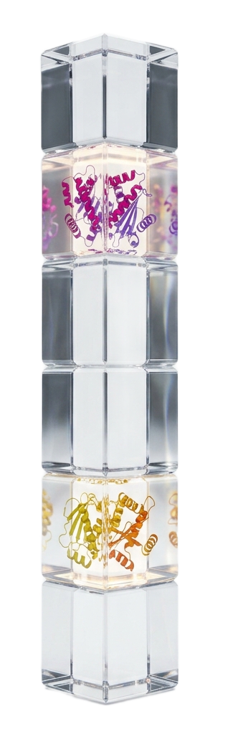
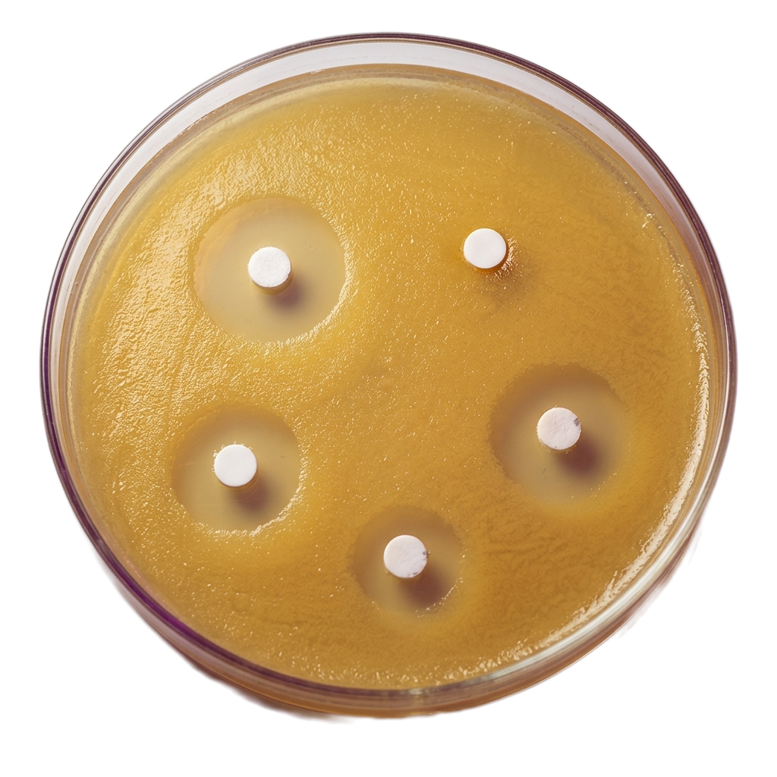
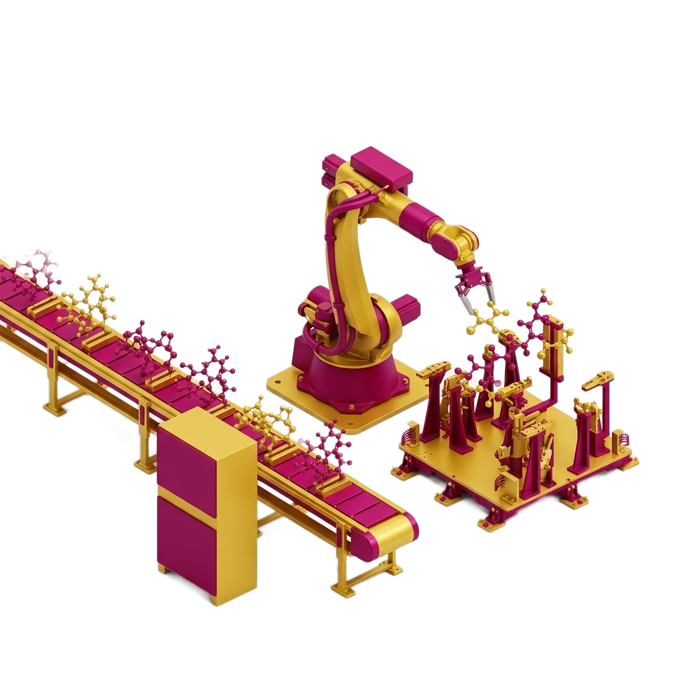



Bryan Saldivar
TGS - AZ: MoAI
rate limits
PostDoc (GenAI)
Patent
3rd - data science BBVA
PhD Mutation prediction.
GenAI
Research assistant
Patent consultant
MS. Public policy
IT engineer
B.Sc. Telecom. Eng.

Slide 2
